Slide 1


Slide 2

Digital narrative –
modelling business processes with Camunda

Slide 3

1
Why should I care about BPMN?
Notes:
Chapter Intro Slide (version P)
This slide should be used at the beginning of each “chapter” of your presentation (as introduced in the Agenda slide) to keep the audience aware of their place in the story and to help break things up. Change the text and chapter number accordingly. If you do not need a sub-head (the smaller text), delete it. Use different backgrounds for different chapter titles, try not to repeat a background.
Very short presentations (< ~10 slides) may not need Chapter Intro Slides.
There are multiple versions of this template with various white and black background images starting on slide 10.

Slide 4
Digital narrative – modelling business processes with Camunda - 1. Why should I care about BPMN?
Business Process Model and Notation
1. SPECIFICATION
Global standard for process modeling.
2. Simplicity
The principle behind BPMN is rather simple and can be understood by non-IT professionals. This minimizes the risk of misunderstandings between business analysts and developers, and it even allows rapid changes in production.
3. Power of expression
If necessary, you can describe precisely how a process functions with BPMN.
4. Implementation in IT
BPMN has been primarily developed to support technical implementation of processes (“Process Automation”).
Notes:
Standard text slide (version 8) Varying the length of the paragraphs as well as using bulleted and numeric lists help with keeping the reader engaged.
Lists help to “skim” the information on the page and allow the audience to absorb a just the key information.

Slide 5
2
BPMN basic concepts
Notes:
Chapter Intro Slide (version P)
This slide should be used at the beginning of each “chapter” of your presentation (as introduced in the Agenda slide) to keep the audience aware of their place in the story and to help break things up. Change the text and chapter number accordingly. If you do not need a sub-head (the smaller text), delete it. Use different backgrounds for different chapter titles, try not to repeat a background.
Very short presentations (< ~10 slides) may not need Chapter Intro Slides.
There are multiple versions of this template with various white and black background images starting on slide 10.

Slide 6
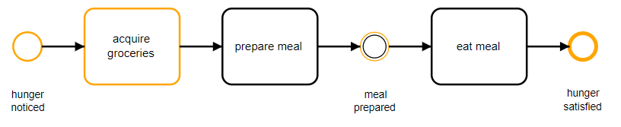
Digital narrative – modelling business processes with Camunda - 2. BPMN basic concepts
Notes:
Standard text slide (version 8) Varying the length of the paragraphs as well as using bulleted and numeric lists help with keeping the reader engaged.
Lists help to “skim” the information on the page and allow the audience to absorb a just the key information.

Slide 7
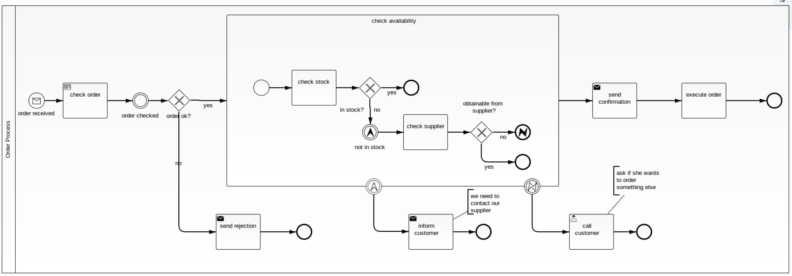
Digital narrative – modelling business processes with Camunda - 2. BPMN basic concepts
Notes:
Standard text slide (version 8) Varying the length of the paragraphs as well as using bulleted and numeric lists help with keeping the reader engaged.
Lists help to “skim” the information on the page and allow the audience to absorb a just the key information.

Slide 8



Presentation Title - 1. Chapter Name
Activities
Task: any executable logic
Subprocess: encapsulates complexity
Call activity: modularization and reuse
Gateways
Exclusive
Parallel
Event-based
EVENTS
Message
Timer
Error
Notes:
Elements (version 2)
Elements are used to give more detail to a set of ideas, they should all relate to the same topic.
Use this page for a list of deliverables, key roles on a project, phases of a project, or any topic that can be broken down into more specific examples.
Each section should have an icon that relates to the content of that specific element, no icon should be repeated on the same page, and they should all be the same colour.
Keep the text to 1-2 sentences and aim to have about the same amount of content under each element.

Slide 9
3
Why Camunda?
Notes:
Chapter Intro Slide (version P)
This slide should be used at the beginning of each “chapter” of your presentation (as introduced in the Agenda slide) to keep the audience aware of their place in the story and to help break things up. Change the text and chapter number accordingly. If you do not need a sub-head (the smaller text), delete it. Use different backgrounds for different chapter titles, try not to repeat a background.
Very short presentations (< ~10 slides) may not need Chapter Intro Slides.
There are multiple versions of this template with various white and black background images starting on slide 10.

Slide 10



Presentation Title - 1. Chapter Name
Standards-based Business-IT Collaboration
Camunda defines workflows using BPMN 2.0 and DMN, providing a common language for technical and non-technical users.
Open Architecture
It provides a highly scalable platform based on open components that can be easily integrated with most common technical architectures or frameworks.
Developer-friendly Approach
The platform is easy to get started and use in your environment right away, with full public access to all docs, open APIs to integrate with just about anything, including the Spring ecosystem.
Notes:
Elements (version 2)
Elements are used to give more detail to a set of ideas, they should all relate to the same topic.
Use this page for a list of deliverables, key roles on a project, phases of a project, or any topic that can be broken down into more specific examples.
Each section should have an icon that relates to the content of that specific element, no icon should be repeated on the same page, and they should all be the same colour.
Keep the text to 1-2 sentences and aim to have about the same amount of content under each element.

Slide 11
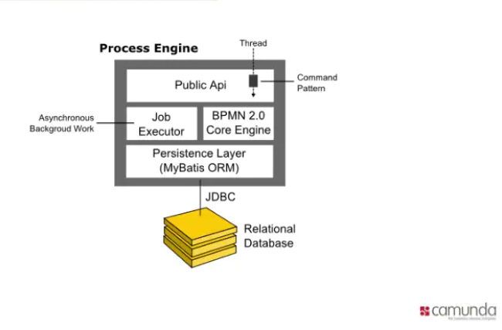
Presentation Title - 1. Chapter Name
Notes:
Elements (version 2)
Elements are used to give more detail to a set of ideas, they should all relate to the same topic.
Use this page for a list of deliverables, key roles on a project, phases of a project, or any topic that can be broken down into more specific examples.
Each section should have an icon that relates to the content of that specific element, no icon should be repeated on the same page, and they should all be the same colour.
Keep the text to 1-2 sentences and aim to have about the same amount of content under each element.

Slide 12
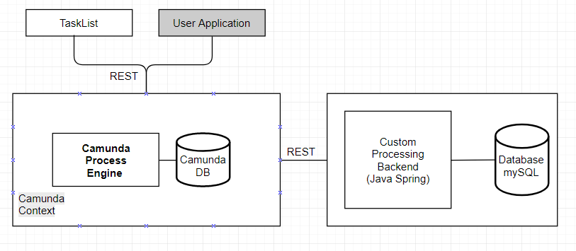
Presentation Title - 1. Chapter Name
Notes:
Elements (version 2)
Elements are used to give more detail to a set of ideas, they should all relate to the same topic.
Use this page for a list of deliverables, key roles on a project, phases of a project, or any topic that can be broken down into more specific examples.
Each section should have an icon that relates to the content of that specific element, no icon should be repeated on the same page, and they should all be the same colour.
Keep the text to 1-2 sentences and aim to have about the same amount of content under each element.

Slide 13
4
Hands-on: Camunda with Spring Boot
Notes:
Chapter Intro Slide (version P)
This slide should be used at the beginning of each “chapter” of your presentation (as introduced in the Agenda slide) to keep the audience aware of their place in the story and to help break things up. Change the text and chapter number accordingly. If you do not need a sub-head (the smaller text), delete it. Use different backgrounds for different chapter titles, try not to repeat a background.
Very short presentations (< ~10 slides) may not need Chapter Intro Slides.
There are multiple versions of this template with various white and black background images starting on slide 10.

Slide 14
5
Why should I care about DMN?
Notes:
Chapter Intro Slide (version P)
This slide should be used at the beginning of each “chapter” of your presentation (as introduced in the Agenda slide) to keep the audience aware of their place in the story and to help break things up. Change the text and chapter number accordingly. If you do not need a sub-head (the smaller text), delete it. Use different backgrounds for different chapter titles, try not to repeat a background.
Very short presentations (< ~10 slides) may not need Chapter Intro Slides.
There are multiple versions of this template with various white and black background images starting on slide 10.

Slide 15
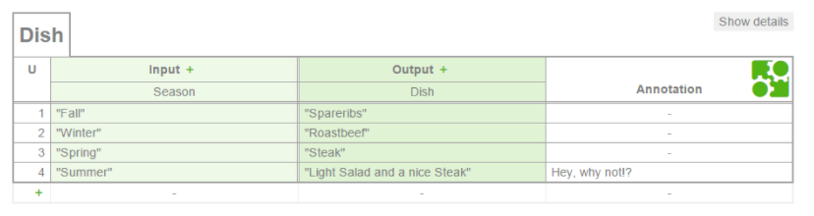
Digital narrative – modelling business processes with Camunda - 1. Why should I care about BPMN?
Decision Model and Notation
1. SPECIFICATION
Global standard for simple decision-making tables.
2. Direct Execution
Business analysts can model the rules that lead to a decision in easy-to-read tables, and those tables can be executed directly by a decision engine (like Camunda). This minimizes the risk of misunderstandings between business analysts and developers, and it even allows rapid changes in production.
3. Experience
The standard does not dictate any special implementation patterns, allowing for modern and lightweight implementations.
Notes:
Standard text slide (version 8) Varying the length of the paragraphs as well as using bulleted and numeric lists help with keeping the reader engaged.
Lists help to “skim” the information on the page and allow the audience to absorb a just the key information.

Slide 16
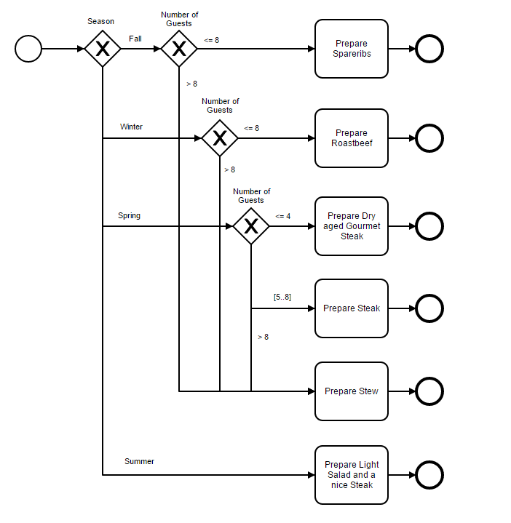
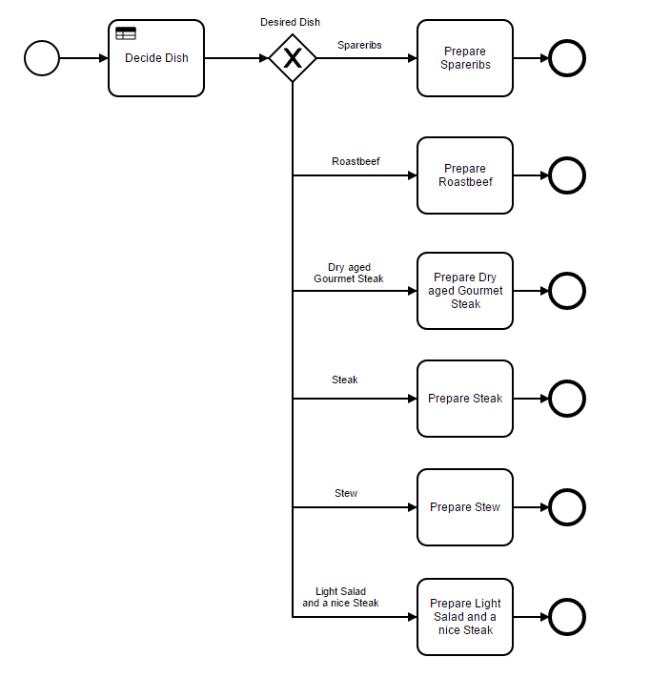
Digital narrative – modelling business processes with Camunda - 1. Why should I care about BPMN?
BPMN
DMN
Notes:
Standard text slide (version 8) Varying the length of the paragraphs as well as using bulleted and numeric lists help with keeping the reader engaged.
Lists help to “skim” the information on the page and allow the audience to absorb a just the key information.

Slide 17
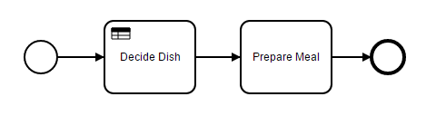
Digital narrative – modelling business processes with Camunda - 1. Why should I care about BPMN?
DMN
Notes:
Standard text slide (version 8) Varying the length of the paragraphs as well as using bulleted and numeric lists help with keeping the reader engaged.
Lists help to “skim” the information on the page and allow the audience to absorb a just the key information.

